Slide 1
Simulation on 3d Solar system
By Saima Islam
Id:21104022
Date: 31st Jan 2025
Lab Project of Computer Graphics
To Miss Ayesha Binte Mostofa

Slide 2
What is it?
A gravitationally bound system consisting of the Sun and all the celestial bodies that orbit it, including planets, moons, asteroids, comets, and other space debris.
Main Components of the Solar System:
The Sun – A massive star at the center that provides light and heat.
Planets (in order from the Sun):
Mercury – Smallest and closest to the Sun.
Venus – Thick atmosphere, very hot.
Earth – The only planet known to support life.
Mars – The "Red Planet," with signs of ancient water.
Jupiter – Largest planet, with a Great Red Spot storm.
Saturn – Famous for its beautiful rings.
Uranus – Rotates on its side, has a blue-green color.
Neptune – Farthest, known for strong winds.

Slide 3
How does the code work ?
This program brings a mini solar system to life using OpenGL! 🌍✨
1️⃣ Sets up the space—defines colors, depth, and camera angle. 2️⃣ Draws the Sun, planets, and orbits—each planet has its own size and color. 3️⃣ Moves planets realistically—using math to place them in circular orbits. 4️⃣ Animates smoothly—planets spin at different speeds like in real life. 5️⃣ Keeps running forever—constantly refreshing the scene for a smooth experience.
In short, it's like a tiny universe on your screen, where planets keep spinning forever! 🚀🔭

Slide 4
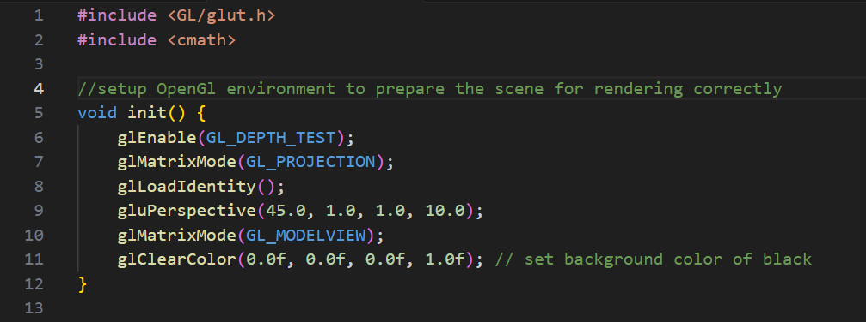
Part a /f:
The init function configures the basic settings for the OpenGL rendering environment:
This functions are used to setup OpenGL environment for graphics rendering for preparing the scene to render properly
Enables depth testing for proper 3D rendering.
Sets up a perspective view.
Prepares the background and object transformations.

Slide 5
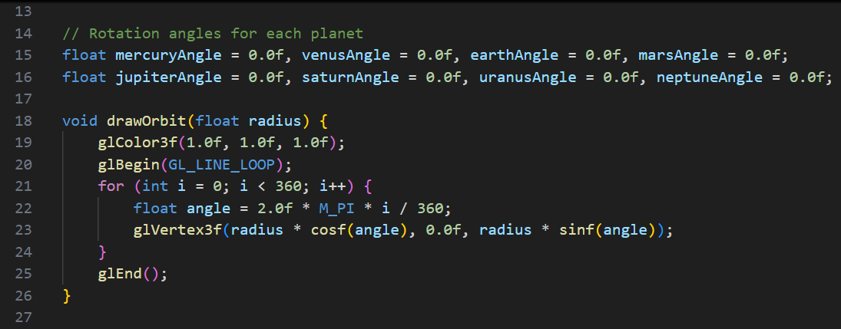
Part b.
Initializes OpenGL settings for 3D rendering.
Stores the rotation angles of the planets (so they can move).
Drawing orbits for the planets.

Slide 6
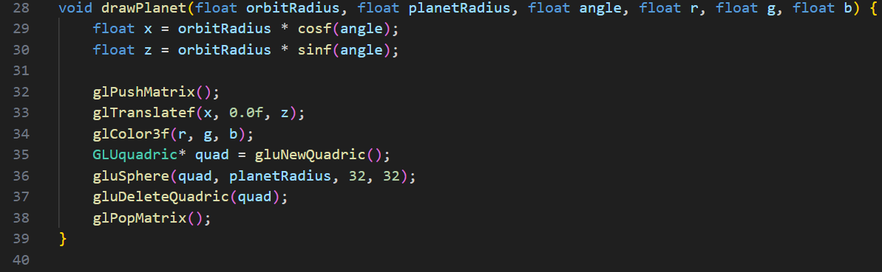
Part c:
📝 What it does:
Calculates the planet's position in space based on its orbit and angle.
Translates OpenGL to that position.
Draws the planet as a sphere with a given radius and color.
Restores the matrix state to avoid affecting other objects in the scene.

Slide 7
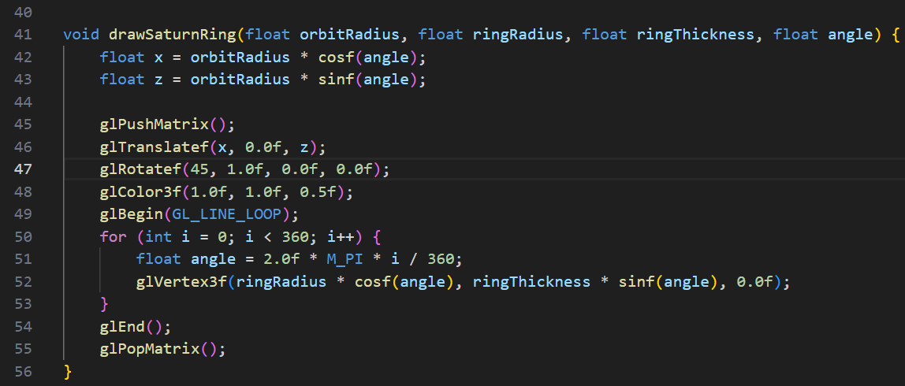
Part d:
Calculates the Saturn's position in its orbit.
Translates the drawing cursor to that position.
Rotates the ring to make it appear correctly around Saturn.
Draws the ring as a 2D circle, adjusting its size and thickness

Slide 8
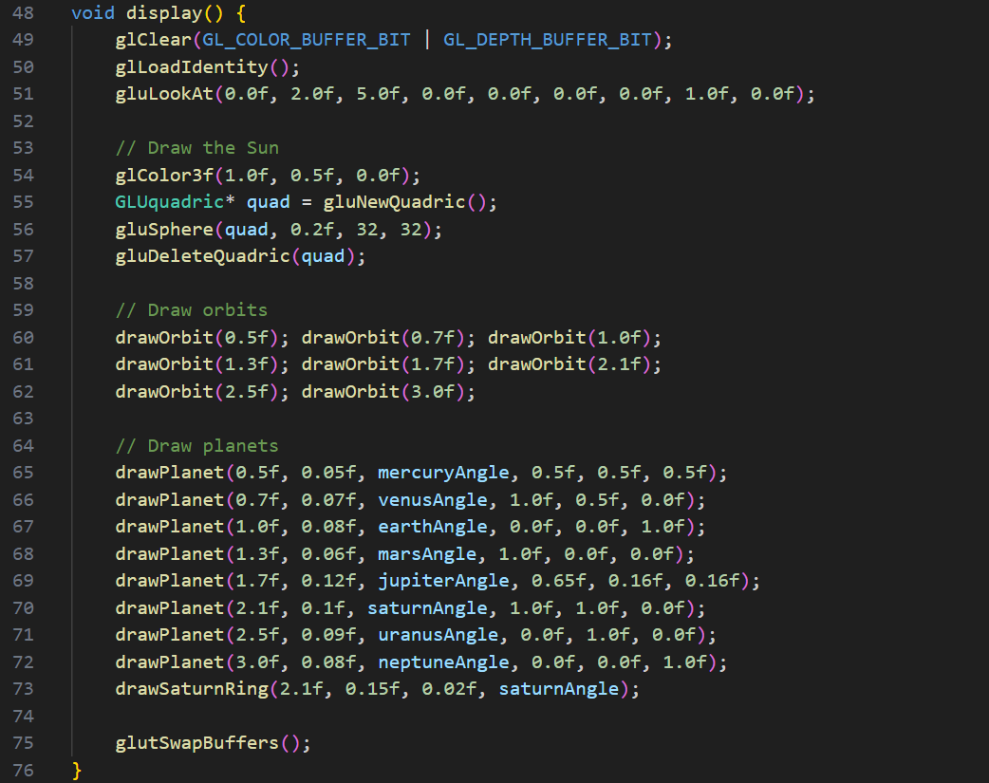
Part e:
Clears the screen and sets up the camera for viewing.
Draws the Sun and its orbits.
Positions and draws the planets according to their orbital parameters.
Draws Saturn's rings and properly positions them.
Swaps the buffers to show the updated scene.

Slide 9
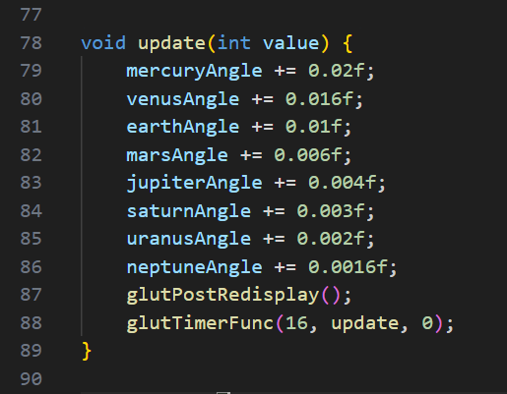
Part e:
Updates the angle of each planet to simulate orbit movement.
Redraws the scene to reflect the new positions.
Schedules the next update in 16 milliseconds for continuous animation.

Slide 10
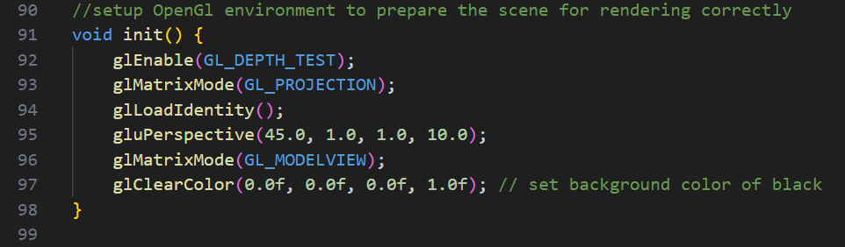
Part a/f:
The init function configures the basic settings for the OpenGL rendering environment:
This functions are used to setup OpenGL environment for graphics rendering for preparing the scene to render properly
Enables depth testing for proper 3D rendering.
Sets up a perspective view.
Prepares the background and object transformations.

Slide 11
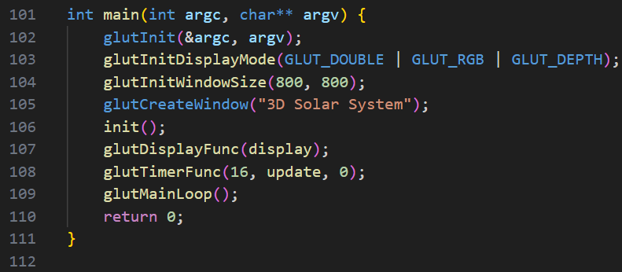
Part g:
Initializes GLUT and sets up the display settings.
Creates a window and prepares OpenGL with init().
Sets up functions for drawing the scene (display) and updating the simulation (update).
Enters the main loop where it keeps rendering and updating the simulation until the program is closed.

Slide 12
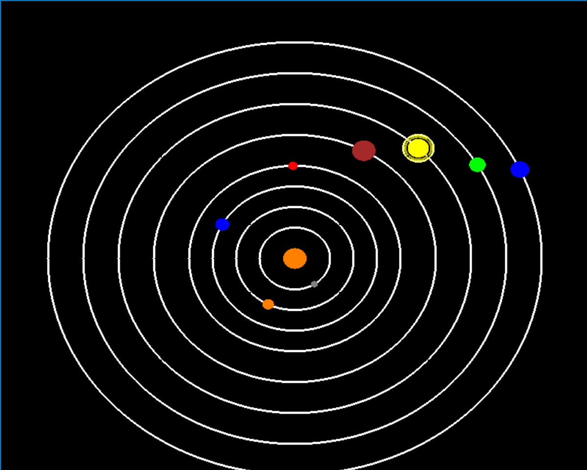

Slide 13
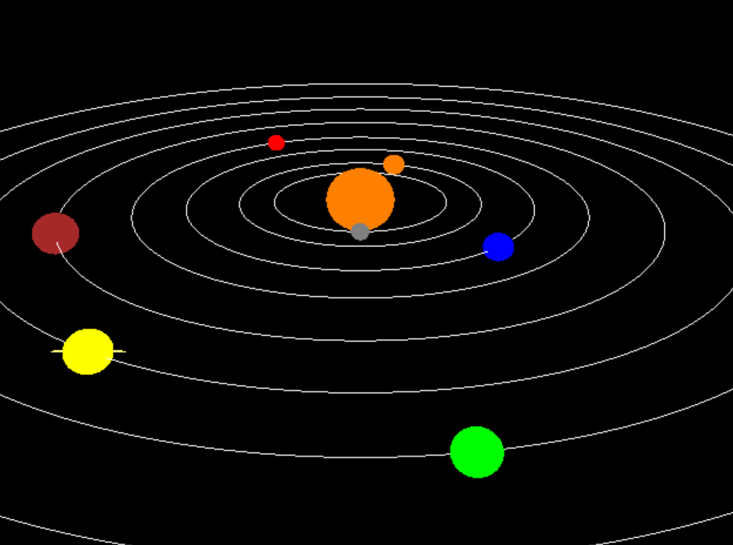

Slide 14
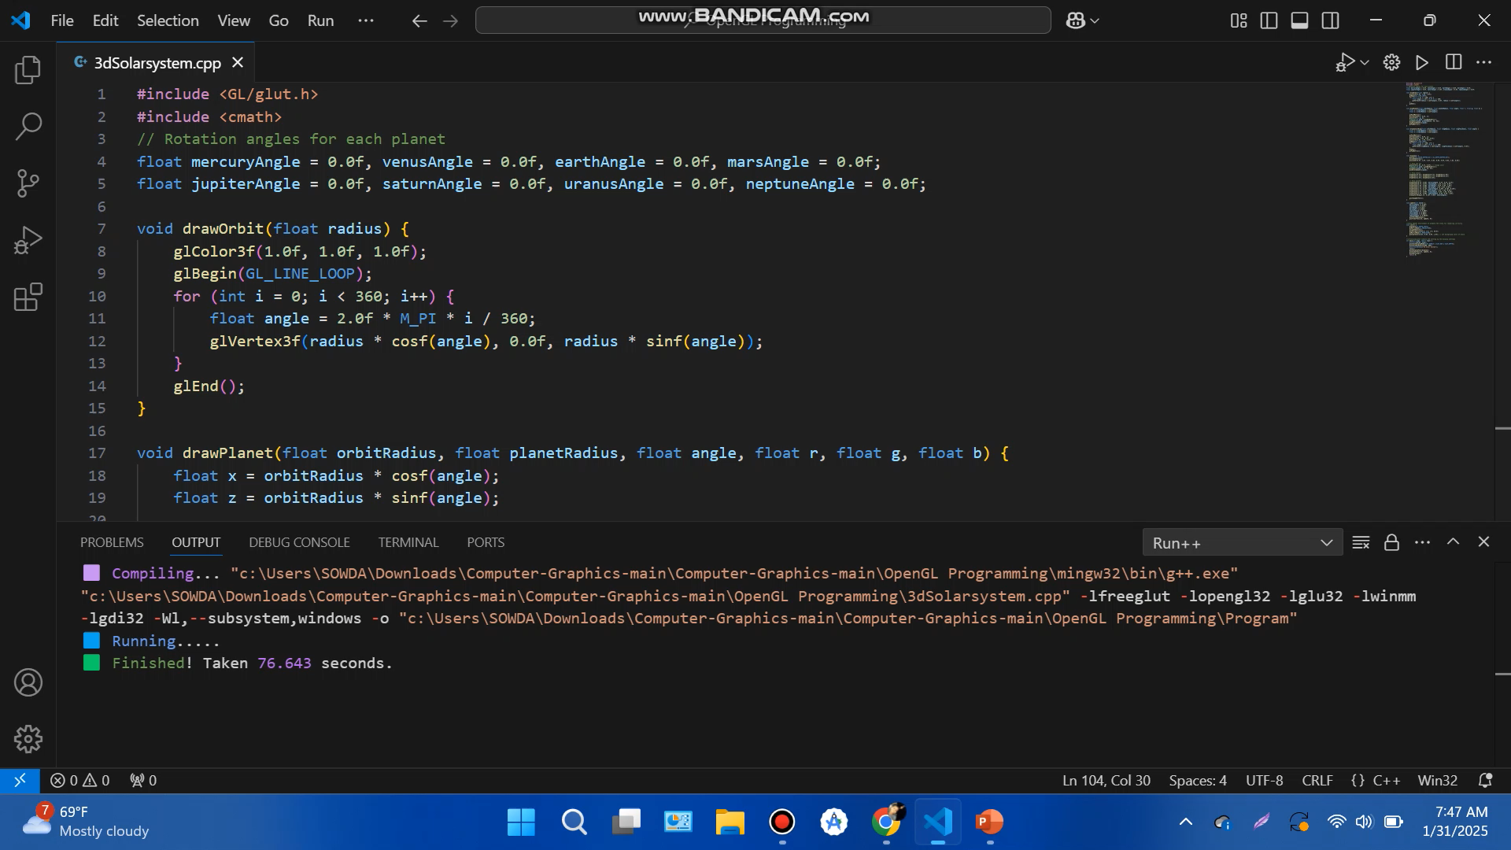

Slide 15
The END .. Thanking you Any Questions?

